Slide 1
Advanced OOP
COMP1011

Slide 2
Agenda
Important Dates
Review
Creating GUI’s
Converting class diagrams into code

Slide 3
Important Dates
Feb 2 – last day to add/drop/PLA
Feb 12 – Test 1
Mar 1 – Assignment 1 due
Mar 12 – Test 2
Mar 23 – last day to withdraw W/O Academic Penalty
Apr 9 – Assignment 2 due
Apr 23 – Test 3

Slide 4
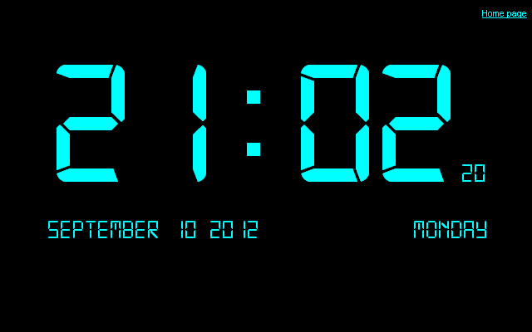
Classes and Objects
Class
Constructors
Overloaded constructors
Validating inputs
Exceptions
Public, Protected, Private

Slide 5
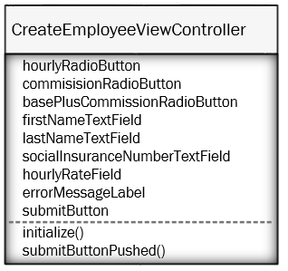
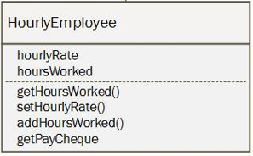
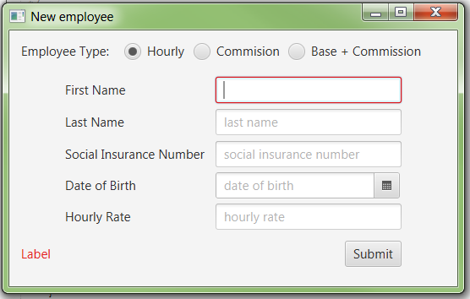
Model, View and Controller (MVC)
Controller
Model
View

Slide 6

TextField
Benefits
Very easy to implement
Supports prompt text
Easy to get information out of the field - just use .getText()
Cons
No validation
Everything comes out as a String (even if you are trying to get numbers or dates)

Slide 7
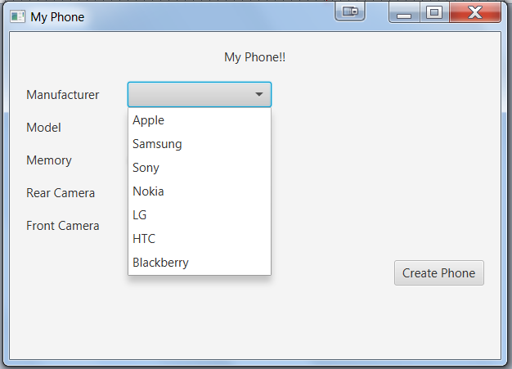
ComboBox
Restricts users to only select from a predefined list
Easy for users
Forces users to select 1 item
Easy to configure if you have the items already in a List
Supports all objects (not just Strings)
https://docs.oracle.com/javase/8/javafx/api/javafx/scene/control/ComboBox.html

Slide 8
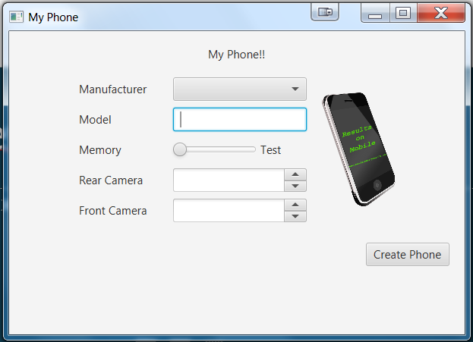
ImageView
ImageView object can hold & display an Image
Image objects load based on the classpath
When loading an image, be sure to use the keyword “file:” otherwise you will trigger an invalid URL exception

Slide 9

Sliders and Labels
Benefits
Easy for users to use
Supports, max, min and default values
Can add or remove tick marks
Can setup a change listener to update the label when the value changed
https://docs.oracle.com/javafx/2/ui_controls/slider.htm
Cons
Presentation of ticks / labels isn’t great

Slide 10

Spinner
Can be loaded with any type of object (Although typically done with numbers)
Similar functionality to a ComboBox, but only uses 1 line of the display
Requires the use of a SpinnerValueFactory
The “TextField” part of the spinner can be made editable. But it will not allow values outside the range of the ValueFactory
https://docs.oracle.com/javase/8/javafx/api/javafx/scene/control/Spinner.html
Notes:
A SpinnerValueFactory is sort of like a ObservableList in a ComboBox. It tells the Spinner object what the display/selection options are.

Slide 11
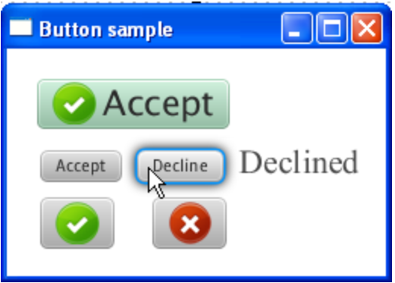
Button
Excellent for triggering action on the scene
Text and images can be changed
Size can be created automatically or set to specific sizes
Use css to style it
https://docs.oracle.com/javase/8/javafx/api/javafx/scene/control/Button.html
https://docs.oracle.com/javafx/2/ui_controls/button.htm
Excellent for triggering action on the scene
Text can be edited and changed based on scene changes
Size can be created automatically or set to specific sizes
https://docs.oracle.com/javase/8/javafx/api/javafx/scene/control/Button.html
https://docs.oracle.com/javafx/2/ui_controls/button.htm

Slide 12
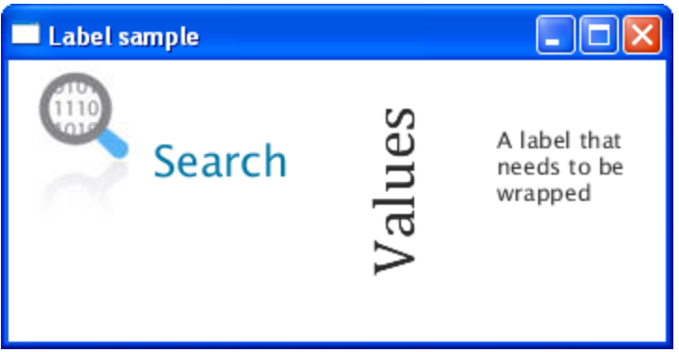
Label
Used just to display text, users cannot interact with them
Controller can modify the text with .setText()
CSS can style the fonts
Alignment / angle can be changed
Can support ImageView in label
https://docs.oracle.com/javafx/2/ui_controls/label.htm

Slide 13
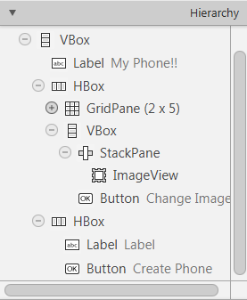
Hierarchy in SceneBuilder
Easy way to select objects in SceneBuilder (especially containers)
Can drag elements directly into the Hierarchy
Maps to the fxml structure
Affects the tab order

